Slide 1




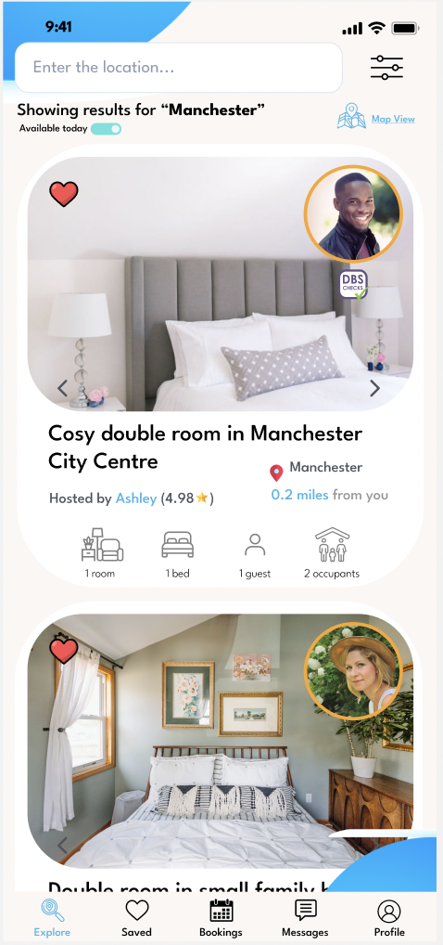
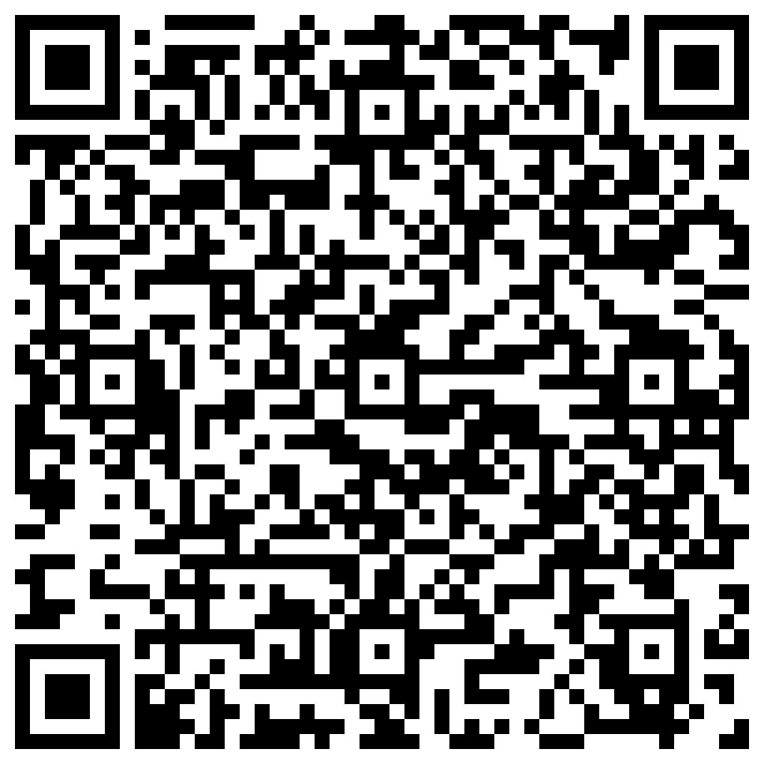
TEAM:CODEBUSTERS
Safe nights start here

Slide 2

Challenge
CODEBUSTERS
Homeless host availability
Response
Real time web app matching people at risk of homelessness with hosts.
Provide
Early intervention and long-term demand
• Secure, automated to self serve reducing logistical burden
• Reporting dashboard to manage ratings and feedback
• Helping Britain prosper

Slide 3
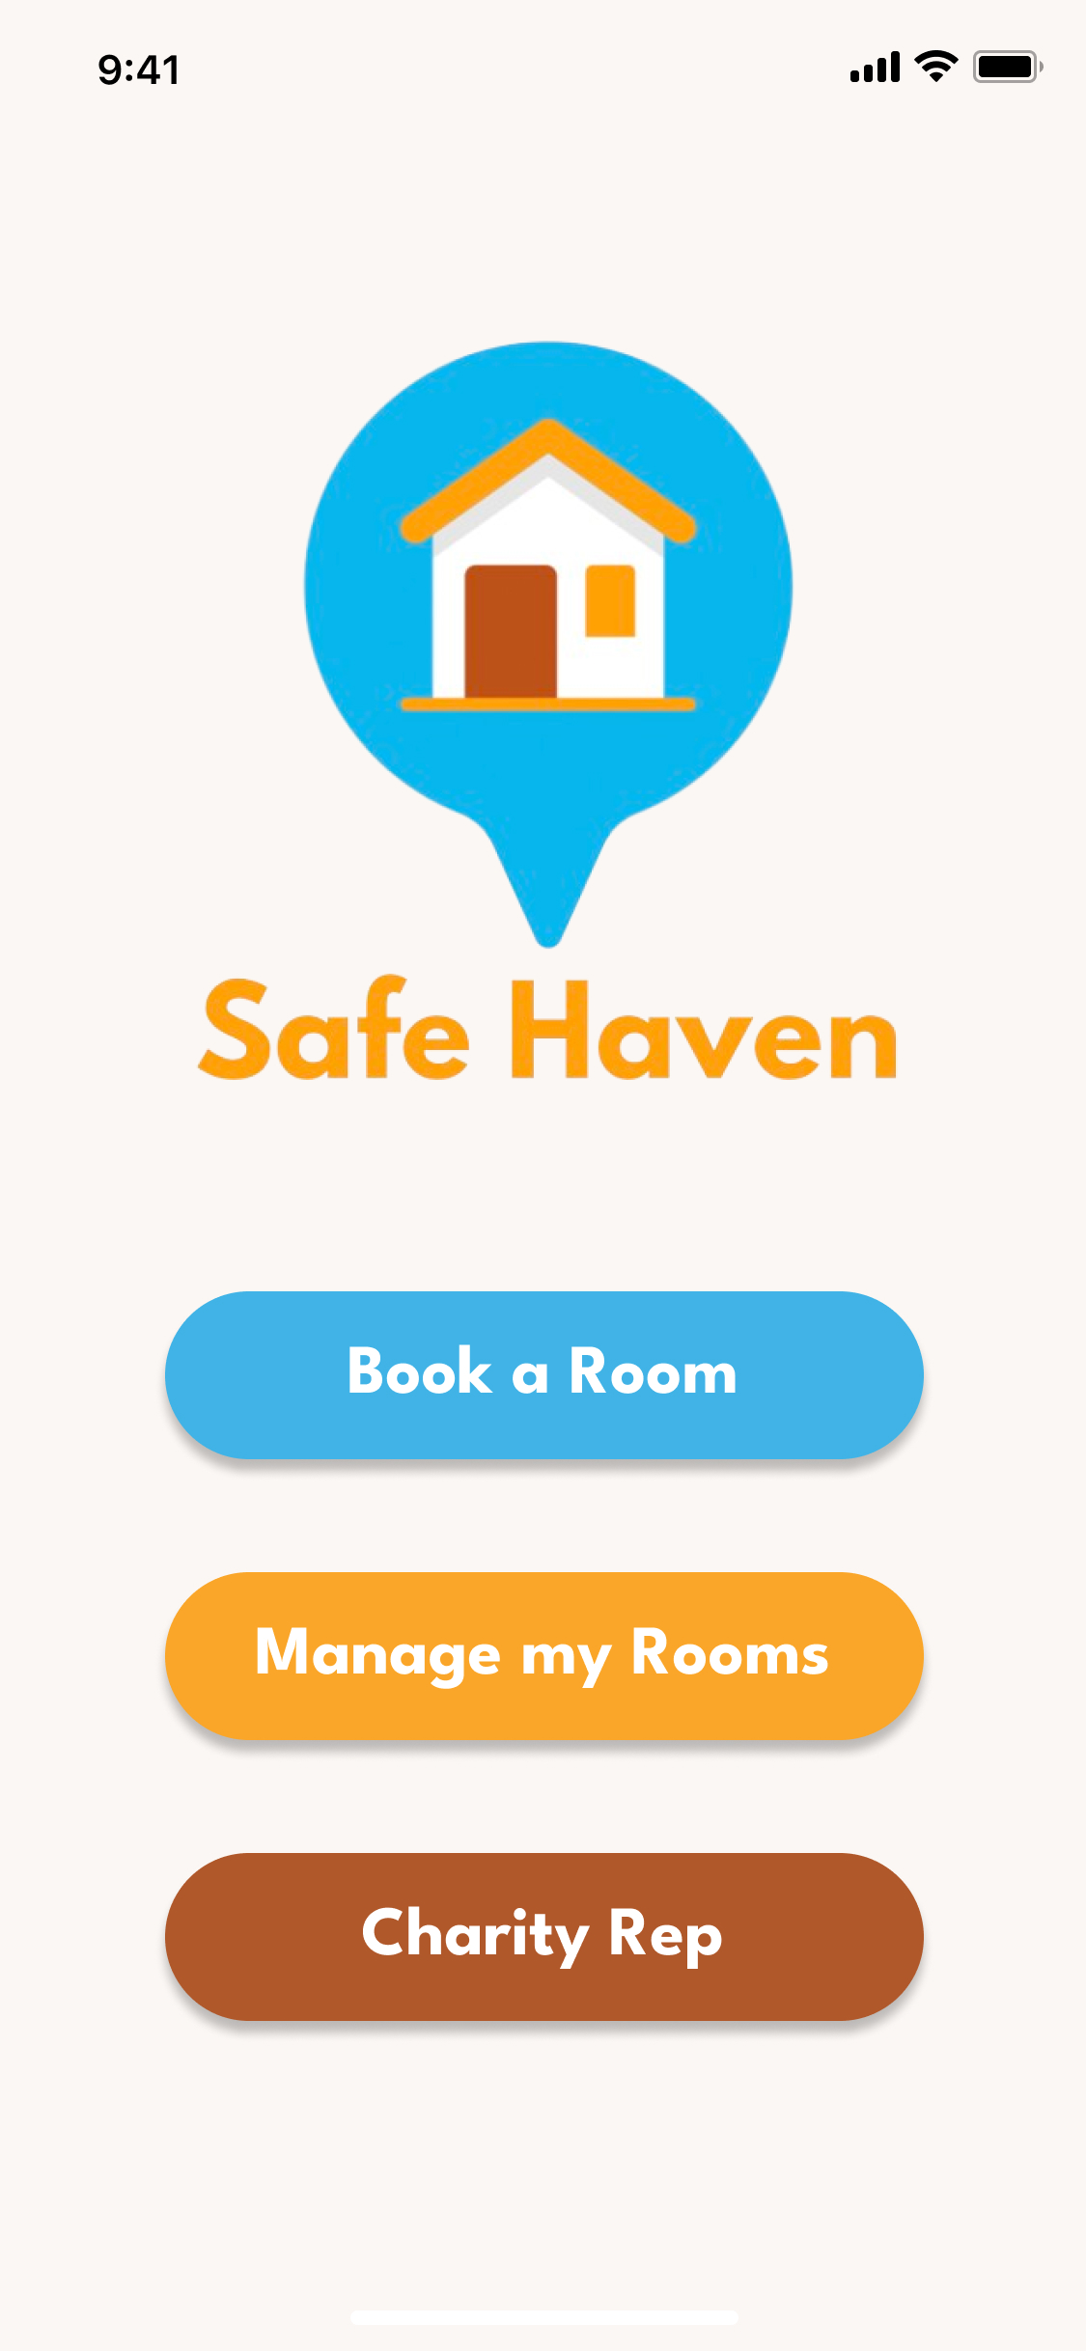
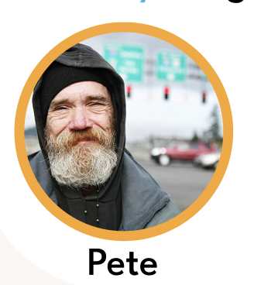


Our user journeys – 3 key users
CODEBUSTERS
“
I am homeless with access to a mobile phone and internet access; I want to book myself into a room to escape the cold.
“
I am a teacher with a spare room in a quiet household, I want to manage my room bookings in a user-friendly manner.
“
I am an outreach worker, walking the streets at night and want a quick and easy way to book rooms for the people I come across.
I am an outreach worker, walking the streets at night and want a quick and easy way to book rooms for the people I come across.

Slide 4
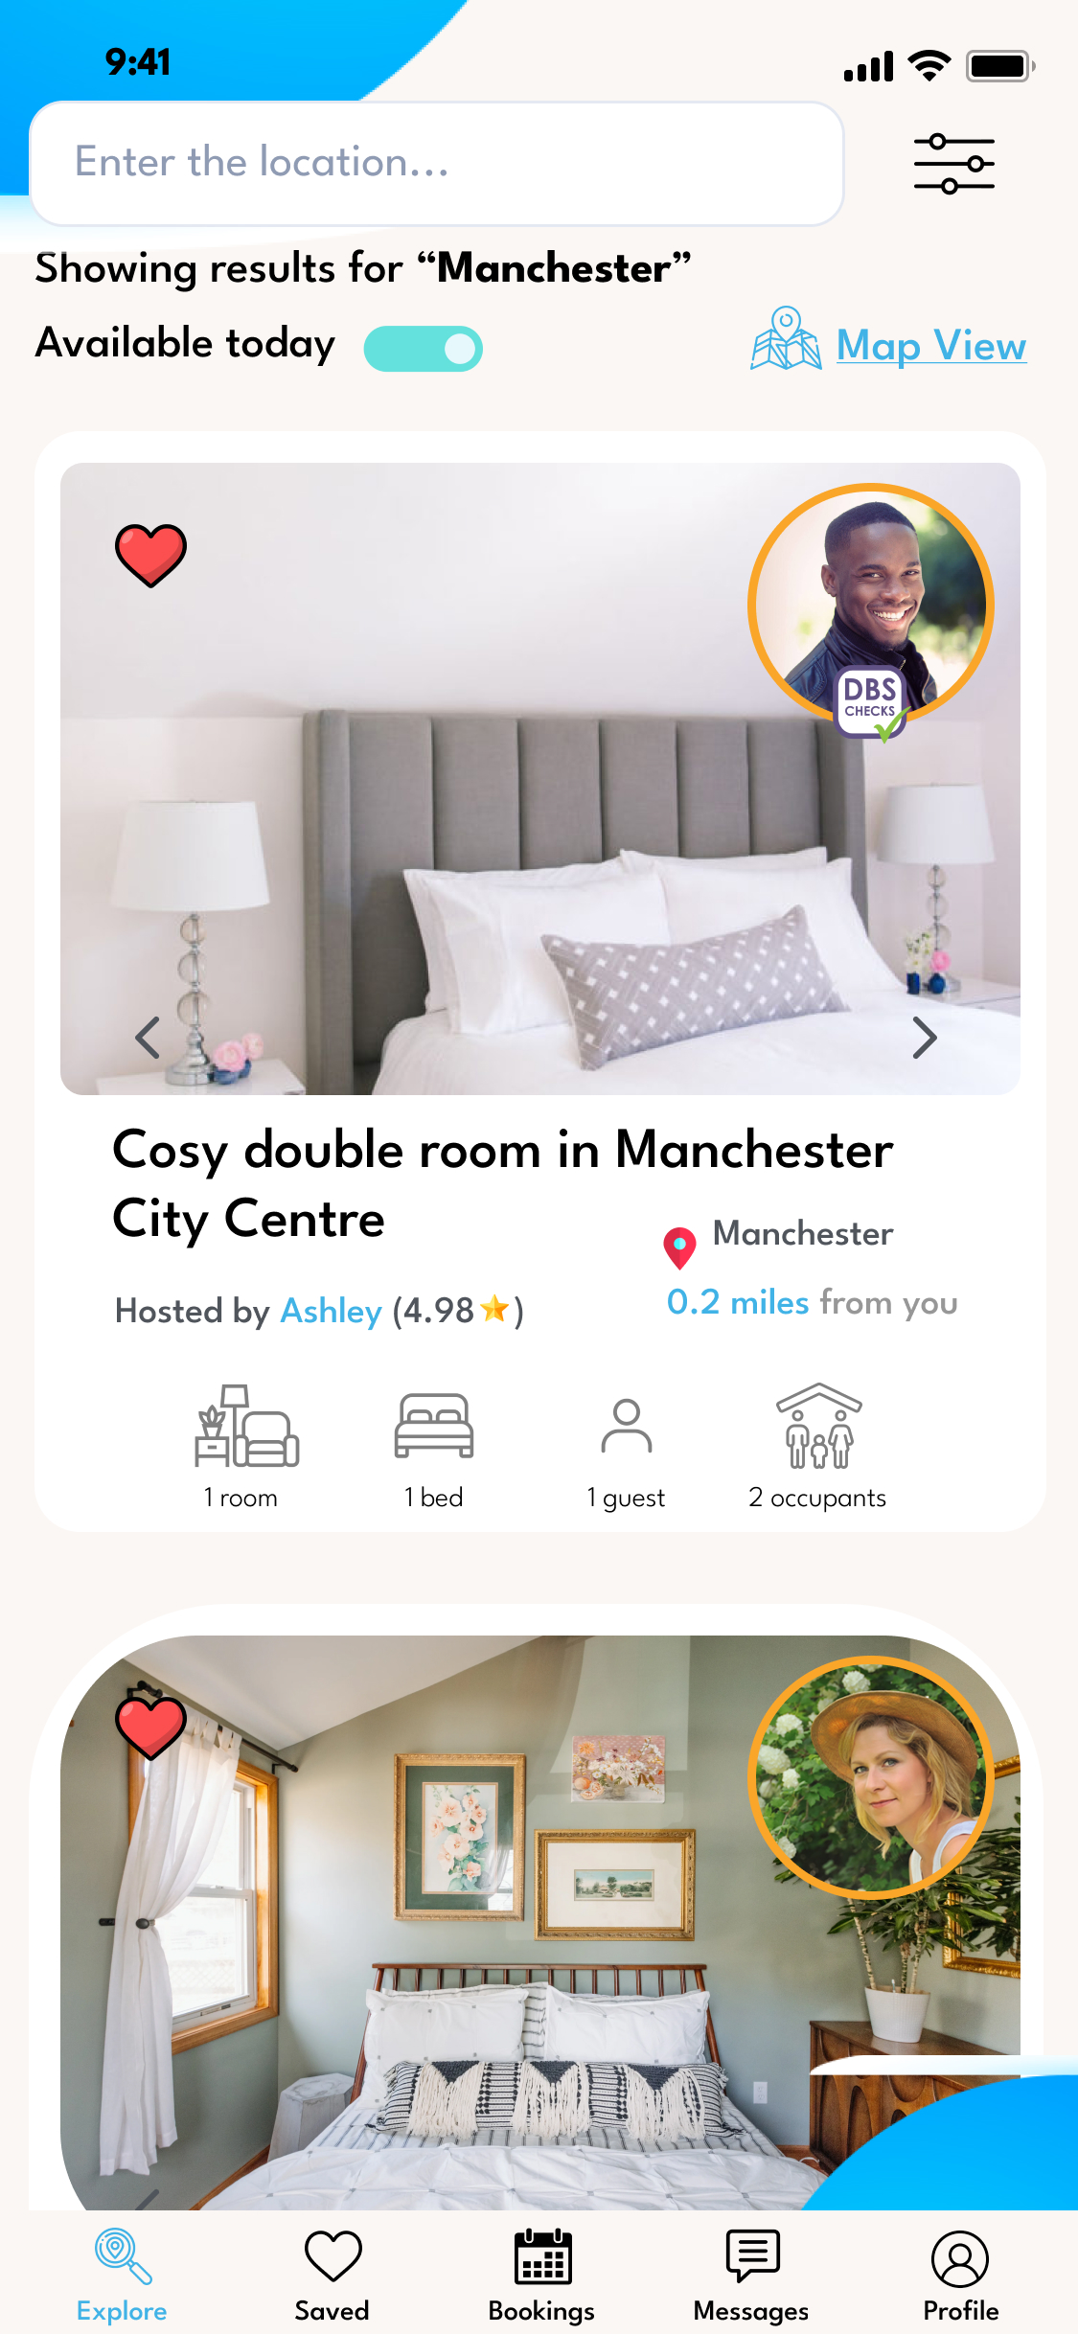
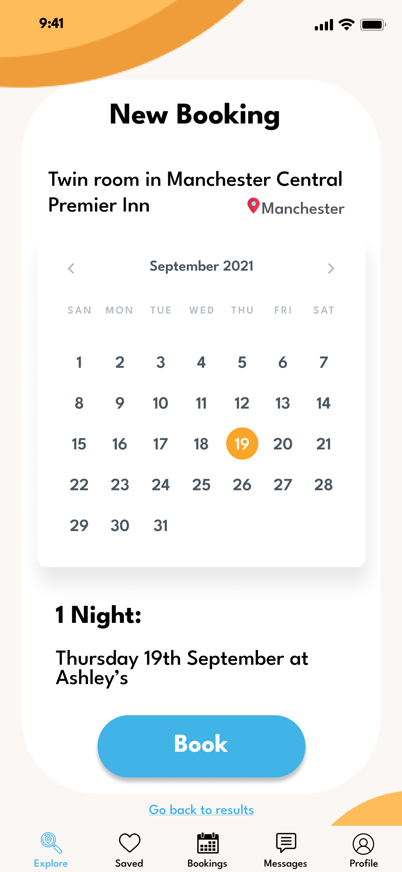
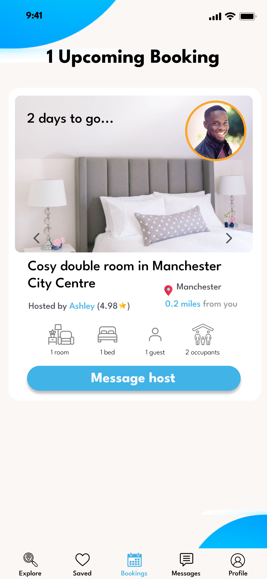
Pete’s Scenario
CODEBUSTERS

Slide 5
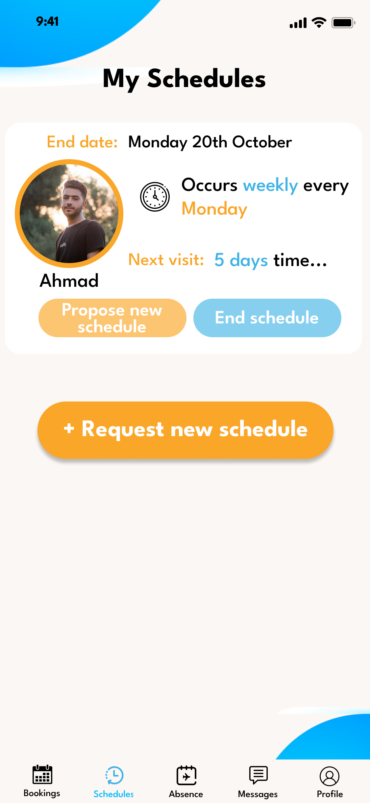
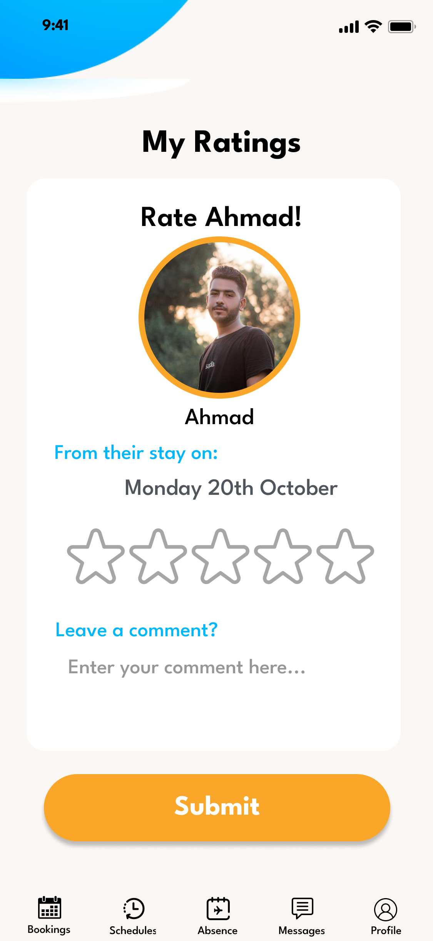
The USP’s
CODEBUSTERS
• Scheduling
• Rate the users

Slide 6
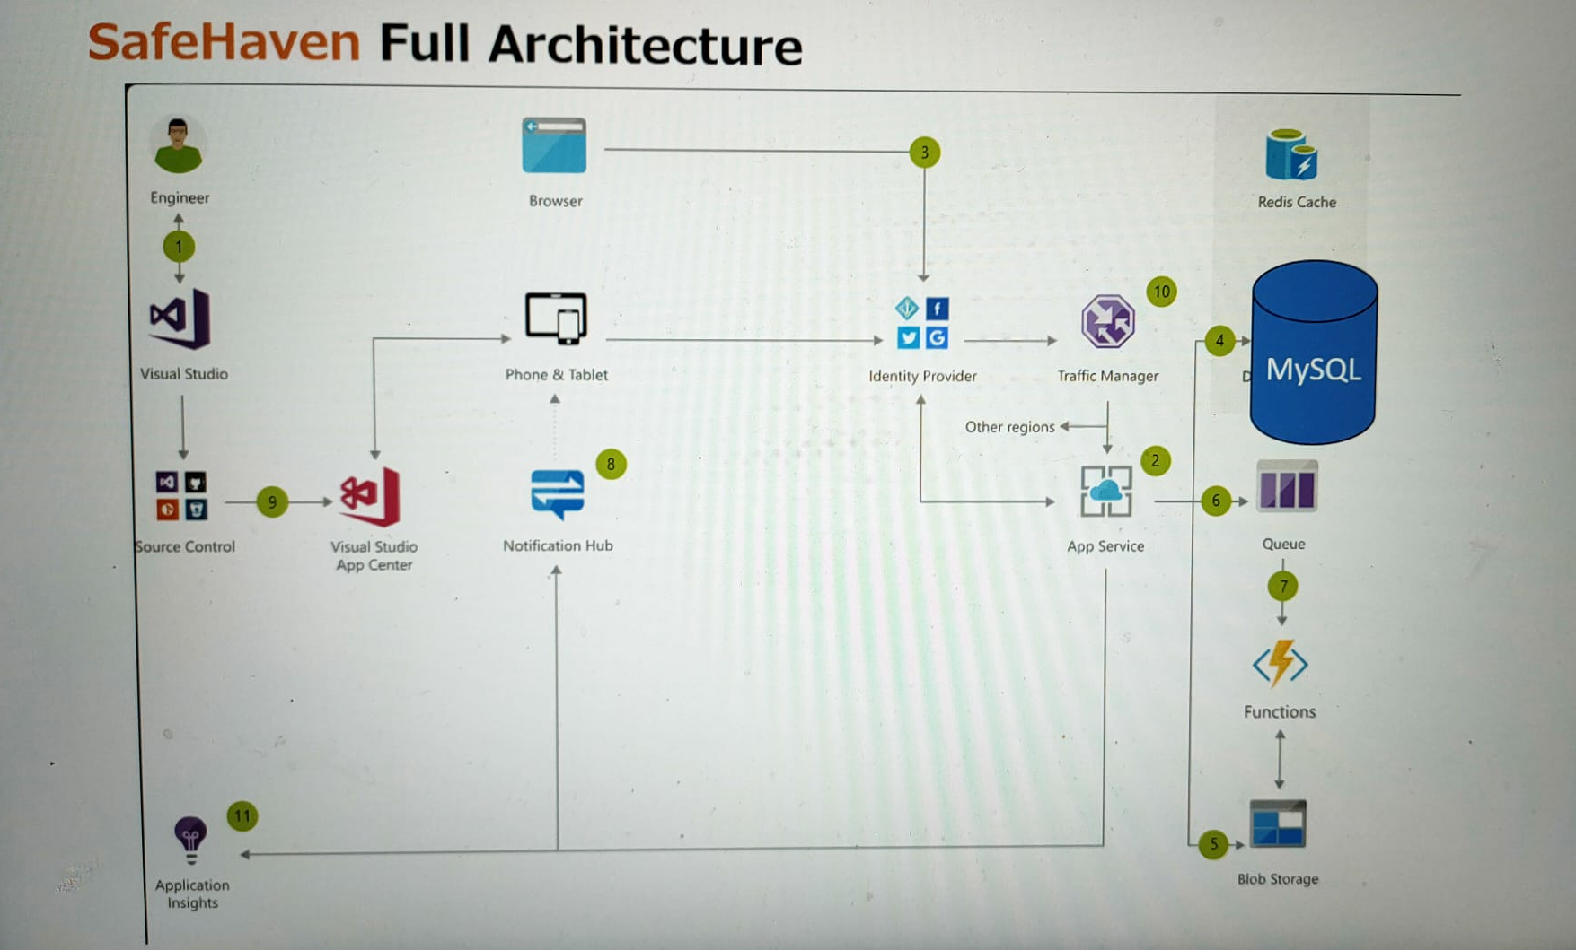
USP’s
CODEBUSTERS

